Slide 1
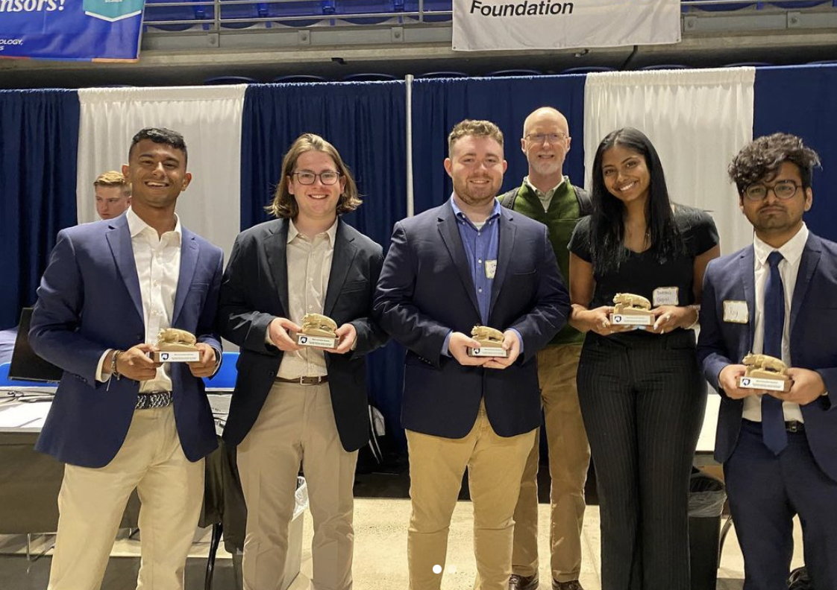

Incorporating Light Detection Systems into Synthetic Vision
Replace this box with key image to introduce talk’s scope, importance, or background
Team #3
Aryan Roy
Jack Casey
George Bodenschatz
Swetha Gopal
Mohit Bhushan
College of Engineering
Pennsylvania State University
April 11th, 2022
[ Awarded: Most Innovative Solution ]
Replace with
your Logo
Notes:
Swetha

Slide 2




In this presentation, we will cover our final solution and how we got there
The Current Problem
Research
Prototype and Implementation
Notes:
Swetha

Slide 3
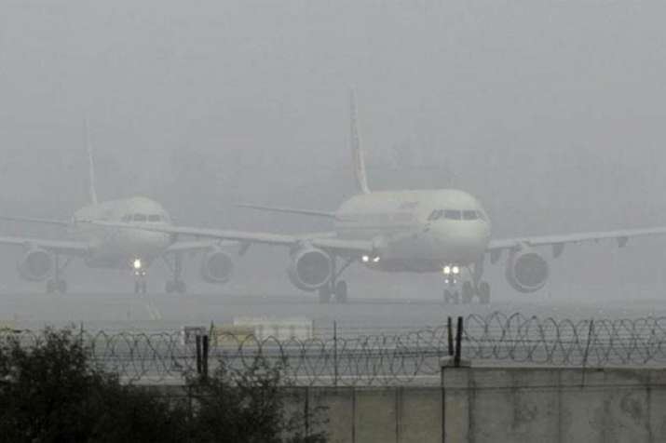
Problem Statement: Address poor visibility through to enable safer taxiing, reduce delays during poor weather
[India TV]
Notes:
Roy

Slide 4
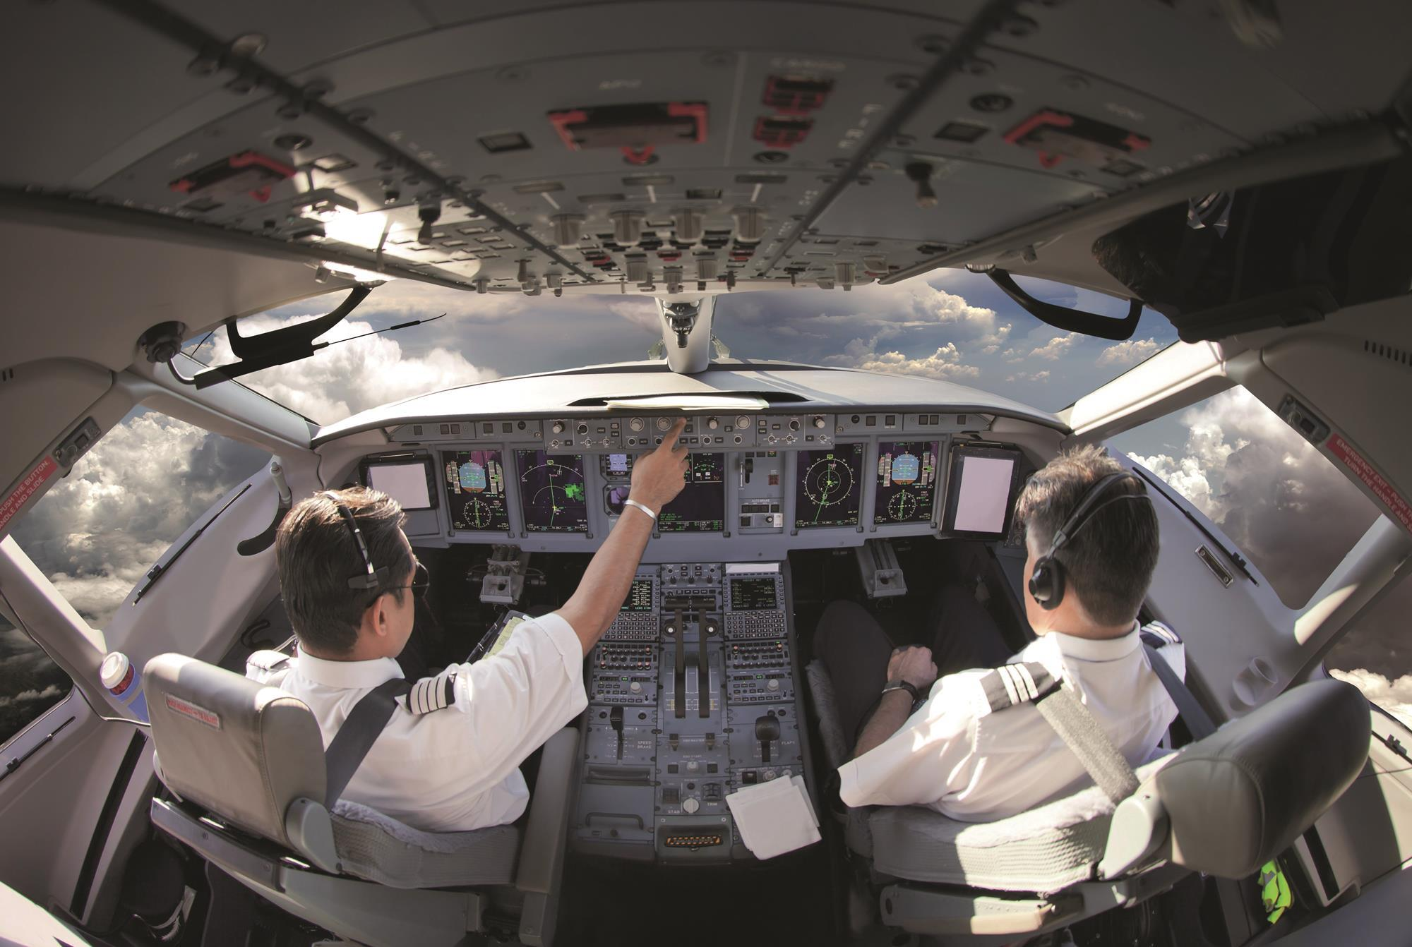
POV Statement: Pilots who are taxiing need better ways to see runways because runways can be dangerous due to low visibility in weather.
[Flight Global]
Notes:
Roy - Figure out a way to correlate that to class

Slide 5
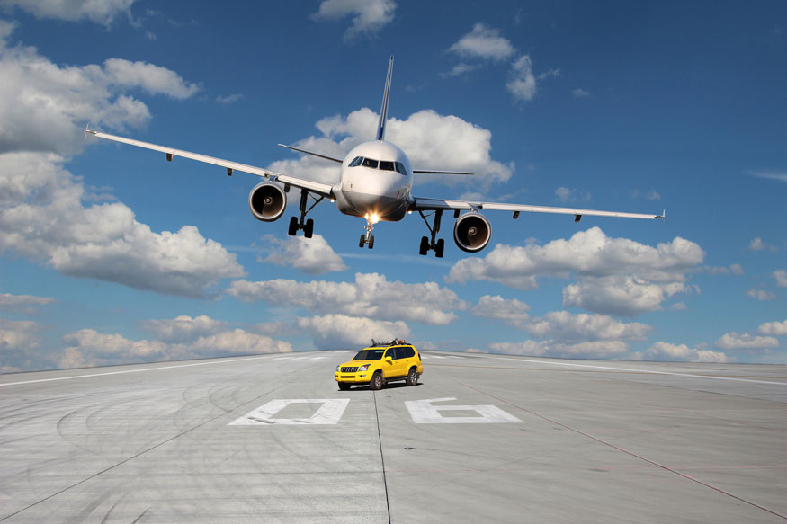
Our goal is to prevent runway incursions by giving aircraft a safer way to taxi
[European Cockpit Association]
Notes:
Roy

Slide 6

Research Summary – Interview with Stakeholders
[DeskTime]
Notes:
Mohit

Slide 7
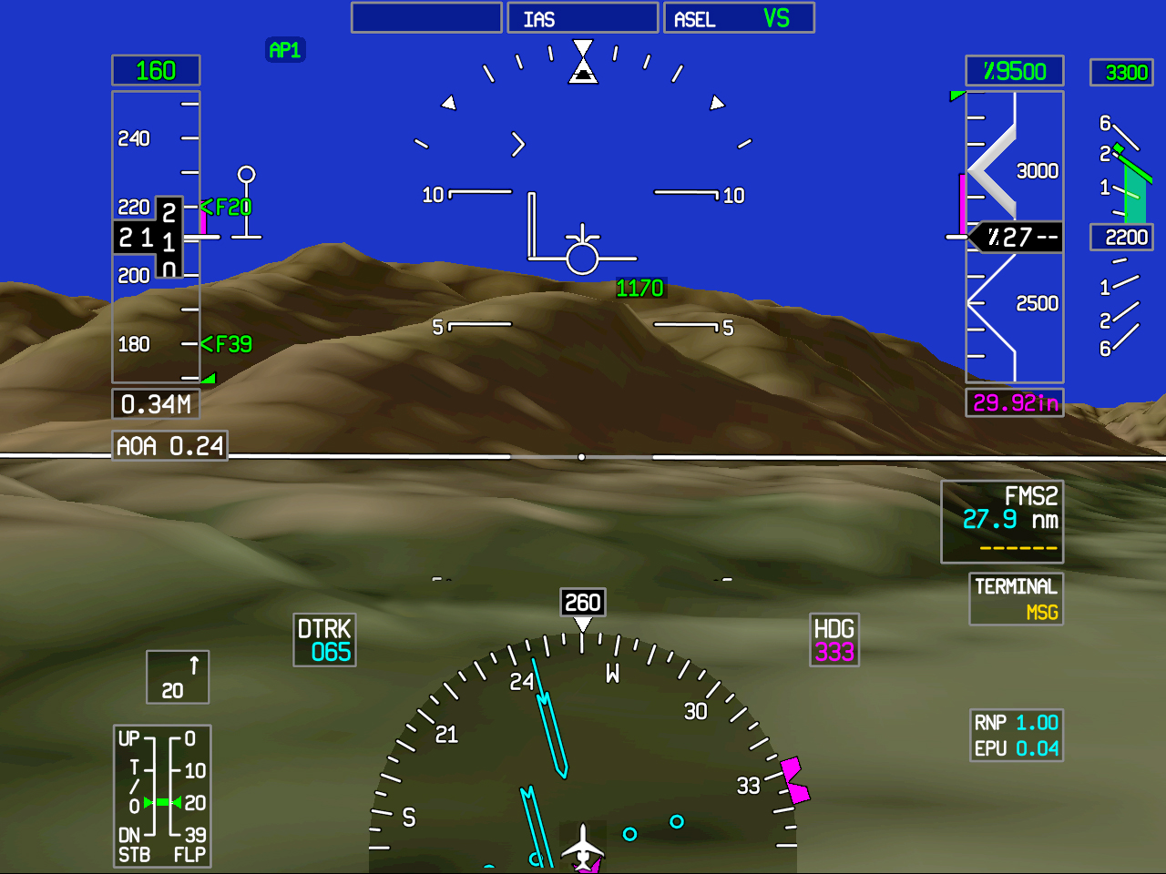
Research Summary – Synthetic Vision
[Wikipedia]
Notes:
Mohit

Slide 8
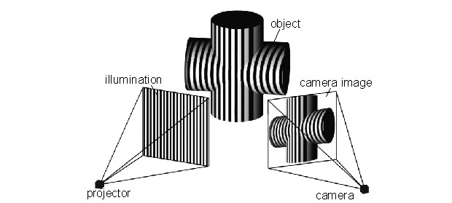
Research Summary – Structured Light
[Wikipedia]
Notes:
George

Slide 9
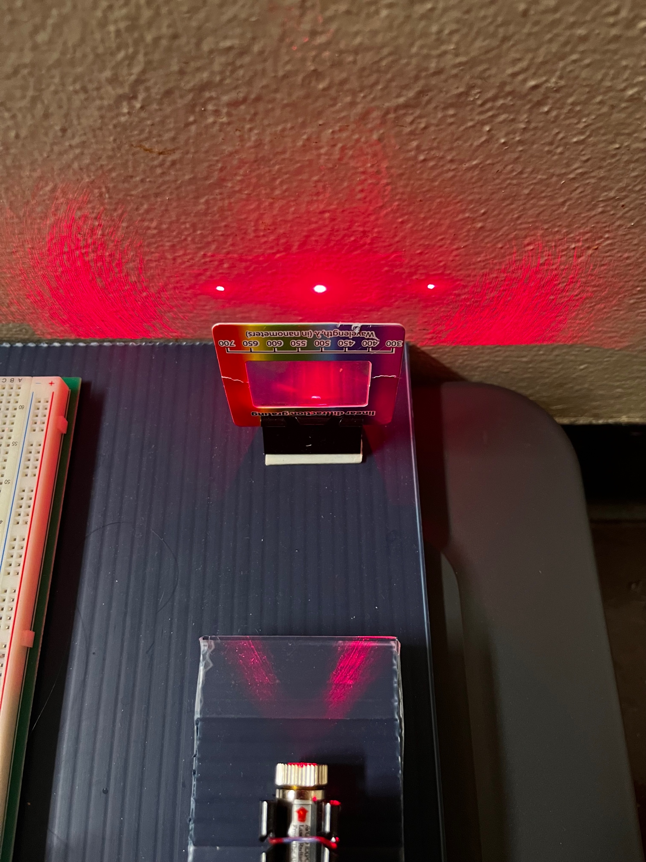
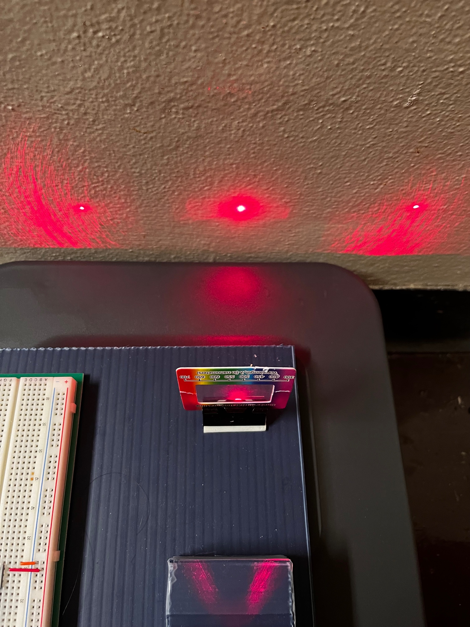
A prototype displaying an example of structured like was created.
Notes:
George

Slide 10
Insights learned when researching the problem and rapid prototyping.
Solutions implementing off the shelf parts are much more achievable.
It is important to understand every component of every step of the process.
Costs are often higher than expected—especially for a novel idea
Notes:
George

Slide 11
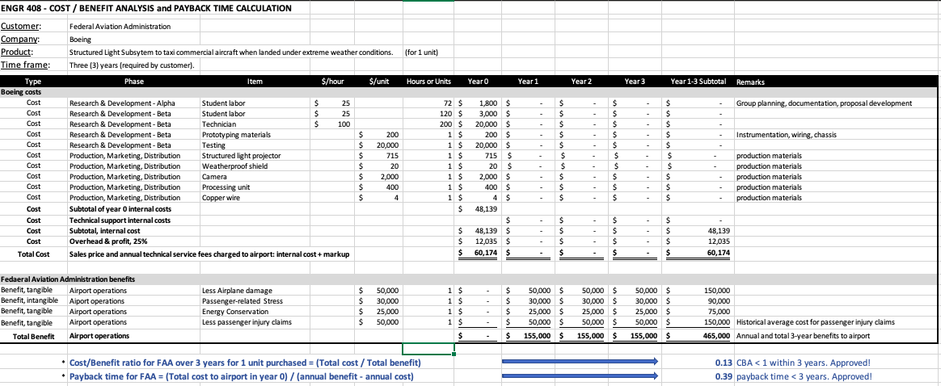

Cost Benefit Analysis
Notes:
Jack-

Slide 12
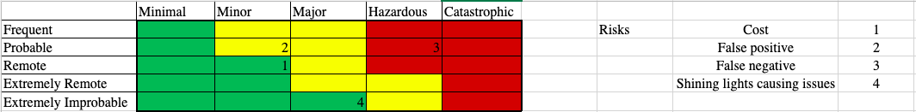
Safety and Risk Assessment
Notes:
Jack-

